Slide 1
SUDAN
* HANAA YOUSOF’S PROJECT *

Slide 2
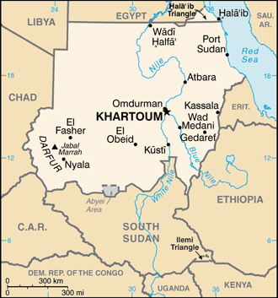
BORDERS
Sudan is an Arab state in North Africa, bordered by:
Egypt to the north ,
The red sea to the northeast,
Eritrea and Ethiopia to the East,
South Sudan To the south ,
The central African Republic to the southwest,
Chad to the west
Libya to the northwest
Notes:
Sudan is an Arab state in north Africa bordered by Egypt to the north , the red sea to the northeast , Eritrea and Ethiopia to the east , South Sudan to the south , the central African republic to the southwest , Chad to the west and Libya to the northwest.

Slide 3
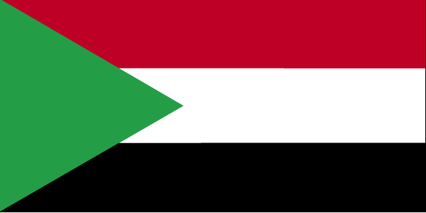
FLAG
What the colours mean:
Red = Sudan’s struggle for independence
White = peace
Black = represents Sudan
Green = agriculture

Slide 4
*facts about Sudan*
Capital: Khartoum
Population: nearly 40 million people !
Area: total: 2,505,813 sq km
Religion: mostly Islam in addition to Christianity
Language :Arabic, English, Many local dialects
Economy: agriculture, animals, oil
Climate: tropical in south, desert in north, different rainy seasons
Currency: Sudanese pound

Slide 5
The Nile
The Blue Nile: It begins at Tana lake in Ethiopia and it flows into Sudan from the southeast.
The White Nile is longer and begins at Victoria lake in Uganda.
When the two Niles meet they form the Nile at Khartoum and it flows northward into Egypt, where it finishes in the Mediterranean sea.

Slide 6
Picture of the Nile

Slide 7
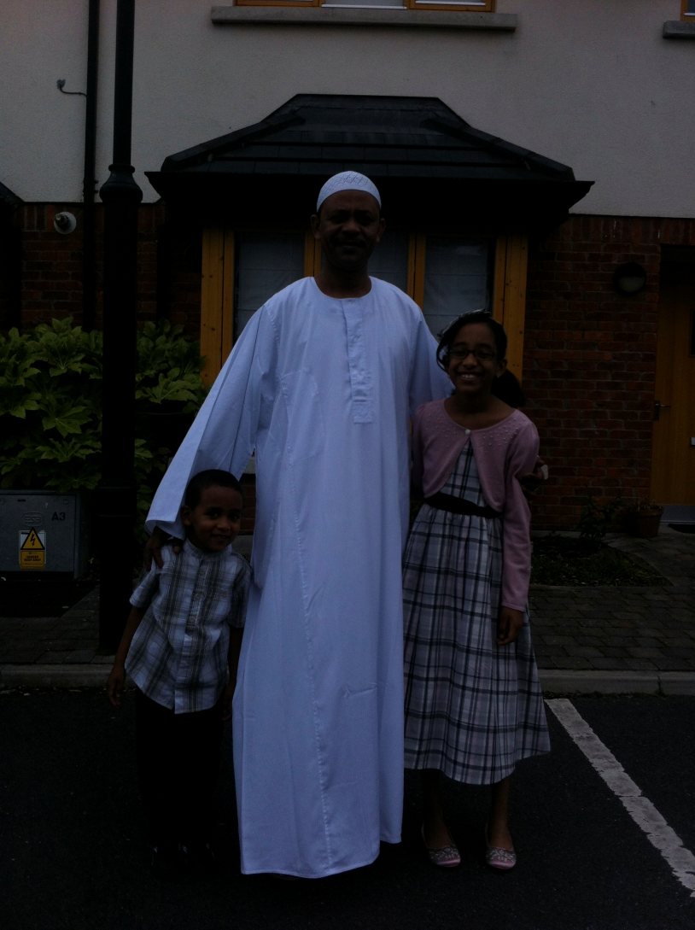
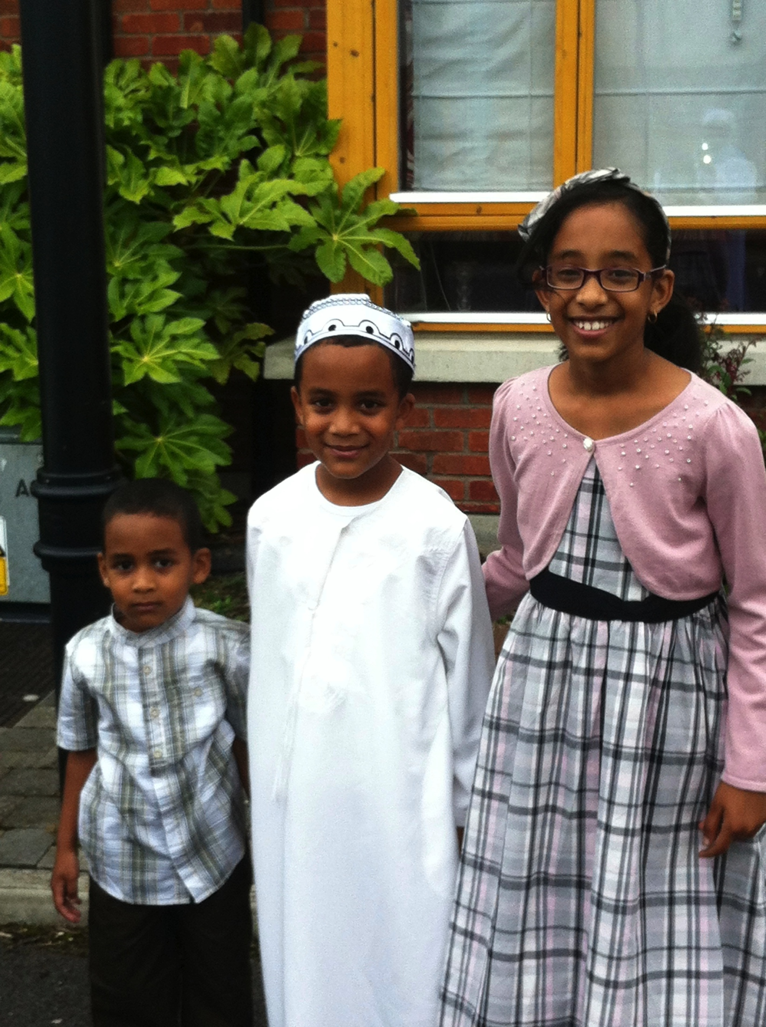
Traditional Dress
Men wear Jallabiya & Imma and Women wear Toub

Slide 8
Mum & I
This is me & my mum in a place in Sudan called Wad Medani .

Slide 9
University of Khartoum
This is the university of Khartoum. It’s the largest and oldest university in Sudan It was established in 1902. The motto is God , Truth , the nation and Humanity.

Slide 10
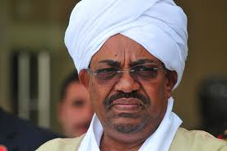
THE RULER
The ruler of Sudan is called Omar Al – Bashir .
Omar Al-Bashir was born in Hosh Bannaga, just north of the capital , Khartoum
This picture is of Omar Al – Bashir

Slide 11
Arabic lesson
Hello= salam alaykom
School= madrasa
homework = wajib
Thank you = shukran
please = law samahta
Can = momkin
enough = khalas
I finished = khalasta
goodbye= maa salama

Slide 12
* THE QUIZ *
Finish the sentence :
The university of Khartoum was established in ___ .
The motto is god , ____ , ________ and Humanity .
My mum and I went to a place called M_ d _ ni
The currency is : __________ _______
Shukran in Arabic means _______ .
The traditional dress for men is _______ and for women _______ .

Slide 13
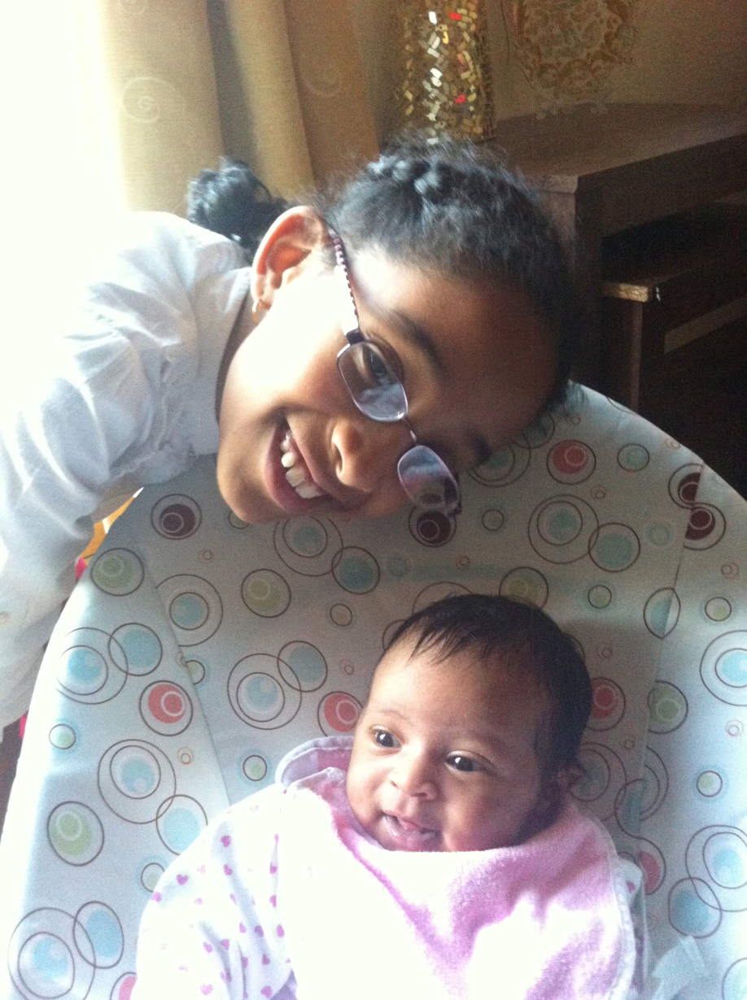
THE END
I hope you liked my project and …..
THANK YOU !!!!
Me and my baby sister

