Slide 1
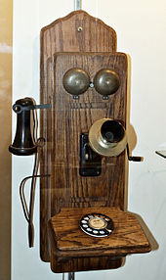
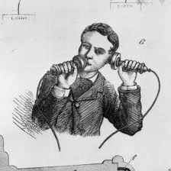
Individual who is the first to develop or manufacturer something. An inventor may invent something totally from scratch or may build upon an already established foundation. Who invented the telephone?

Slide 2
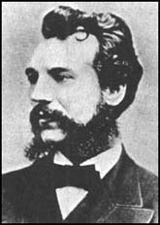
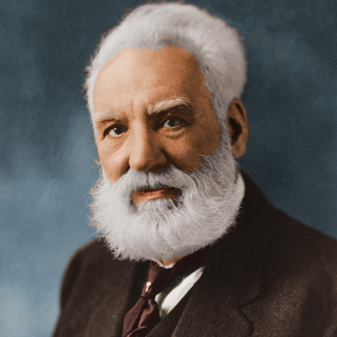
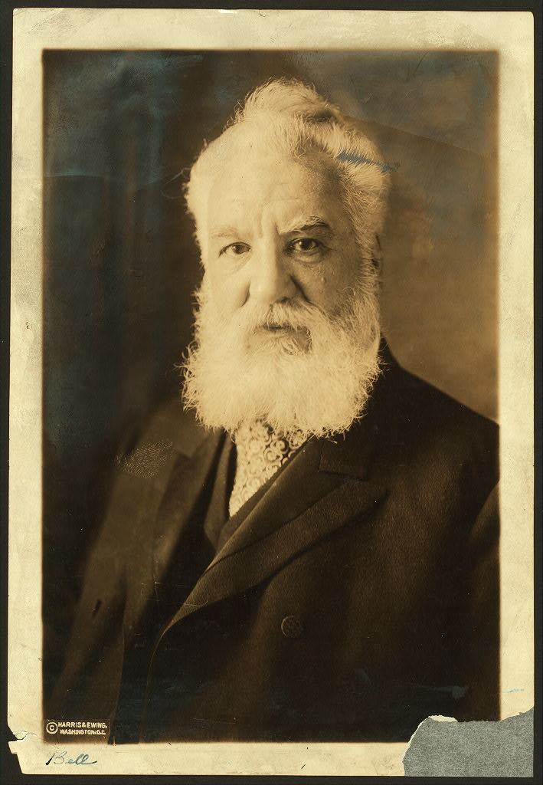
Alexander Graham Bell
born in Edinburgh, Scotland on 3rd March, 1847
How many years ago was that?

Slide 3
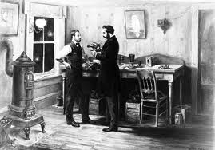
The First Telephonic Transmission
Bell was fascinated by the idea of transmitting speech, and by 1875 had come up with a simple receiver that could turn electricity into sound. He worked on this with his assistant, Thomas Watson.

Slide 4
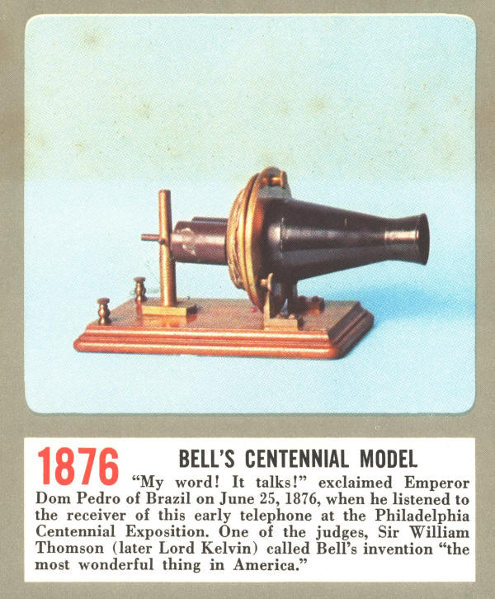
Patenting What does ‘patented’ mean?
Lots of people were working on inventing the telephone so there is controversy about who actually invented the first telephone but Bell patented the telephone first on 3rd March, 1876.

Slide 5
Bell Telephone Company
Within a year the first telephone exchange was built in Connecticut and the Bell Telephone Company was created in 1877, with Bell the owner of a third of the shares, quickly making him a wealthy man.

Slide 6
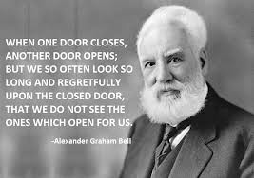
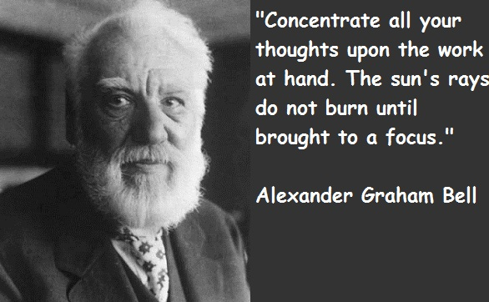
1847 – 1922 How old was he when he died?

Slide 7
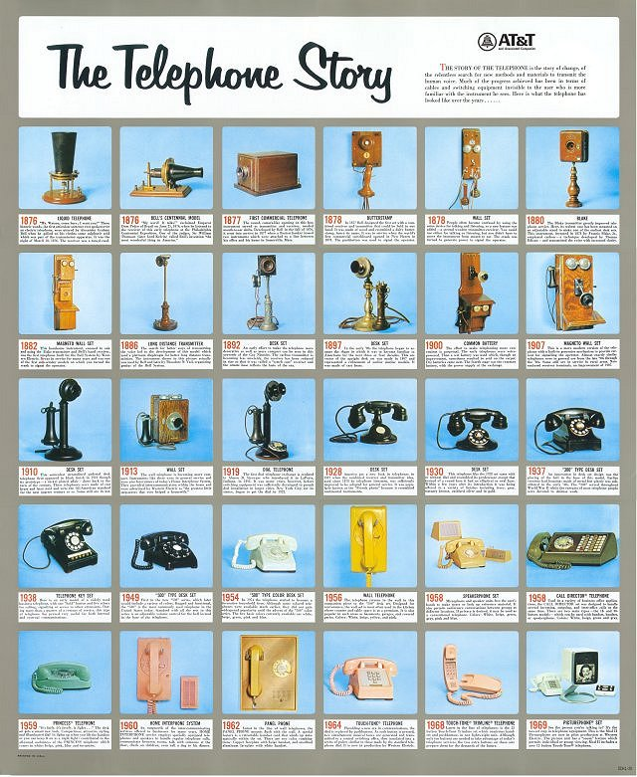
Do you recognise any of these telephones?

Slide 8
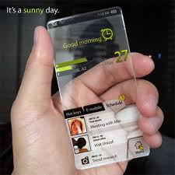
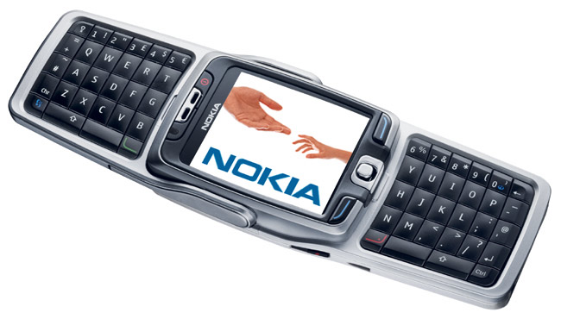
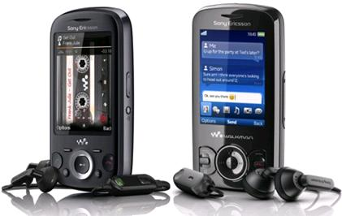
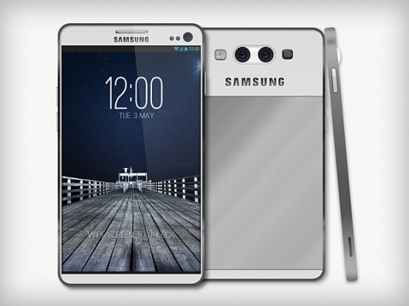
Look how far we’ve come…

Slide 9
Now take a moment…
There are no photos on this page…Are you an inventor? Inventing isn’t about seeing something that’s already there.
Close your eyes, can you see a phone of the future?
What does it look like? What features does it have? What size it? Who will use it?

